Slide 1
Growth Mindset day 4
Room 123

Slide 2
Mistake Video (3 minutes)… (some classes already watched this)
www.youcubed.org/wim-day-5/

Slide 3
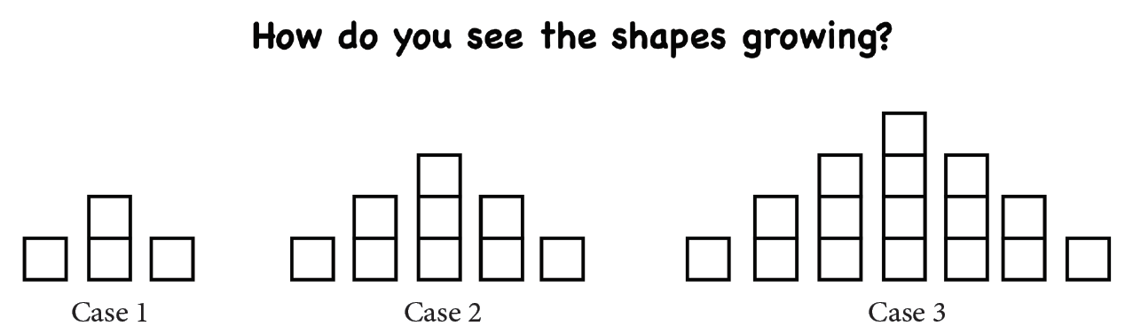
Use colors, shading, and/or words to describe your answer.

Slide 4
How would you complete the chart?
Case Number | Number of Squares
1 | 4
2 | 9
3
4
5
6
15
50
1000
12 – 15 minutes
How can we represent this pattern another way?

Slide 5
Mistake video day 2 (3 minutes)
www.youcubed.org/wim2-day-2/

Slide 6
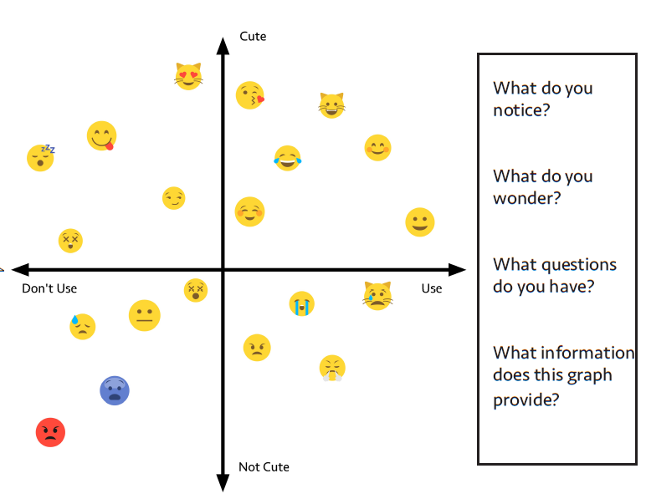
5 – 8 minutes

Slide 7
Speed is not important (3 minutes)
www.youcubed.org/wim2-day-4/

Slide 8
Conjecture
A conjecture is a proposition that is consistent with known data, but hasn’t been proven… yet! In science we call this a hypothesis, in math a conjecture.

Slide 9
Hailstone Sequence (12 – 15 minutes)
Describe what you notice about this sequence
20 – 10 – 5 – 16 – 8 – 4 – 2 – 1

Slide 10
Hailstone Sequence Rules
If a number is even, divide it by 2
If a number is odd, multiply by 3 and add 1

Slide 11
Collatz’ Conjecture (8 – 12 minutes)
Start with any number and follow the previous pattern… what do you notice?

Slide 12
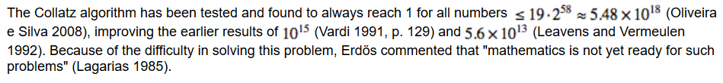
Interesting Fact
In other words, although this appears to always work, there isn’t enough to prove that it is in fact always true… it is one of mathematics unsolved problems!

Slide 13
Our Brains Think about Math Video (3 minutes)
https://bhi61nm2cr3mkdgk1dtaov18-wpengine.netdna-ssl.com/wp-content/uploads/2017/03/Our-Brains-Think-about-Math-Visually.mp4

Slide 14
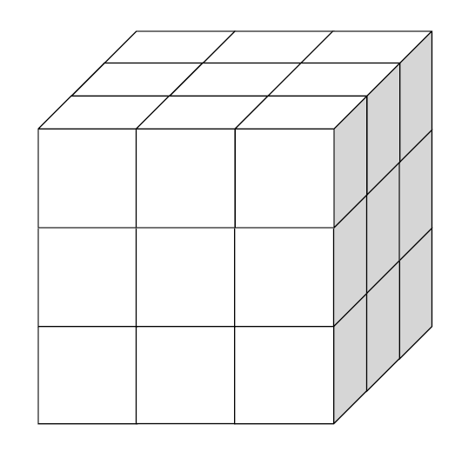
If you were to dip this
cube into paint, then
separate the large cube
into individual cubes, how
many of the small cubes
would have paint on…
0 side? 1 side?
2 sides? 3 sides?
more?
Justify your answer(s).

Slide 15
Exit Ticket
What do you want me to know about you in order to make this year the best year you’ve had in a math classroom?

